Slide 1


Doris Afriyie Amoakohene Supervisor: Toby Dylan Hocking Co-Worker: Anirban
Benchmarking Performance in the data.table Package

Slide 2
Outline of Presentation
Introduction
xxx

Slide 3
Why Benchmarking?
data.table is an extension of R’s data.frame, designed to handle large datasets efficiently
Several major version changes have been introduced, aiming to enhance speed and efficiency. These changes include algorithmic optimizations, memory management improvements, and enhancements to parallel processing capabilities.
To evaluate data.table performance, it is essential to employ benchmarking methodologies. The approach, I used to utilize the atime and atime_versions function from the atime package, which measures the actual execution time of specific operations.

Slide 4
Why Benchmarking?
The atime function allows to compare and visualize the asymptotic performance (time and memory usage) of the different functions
The atime_versions allows for accurate comparisons between different versions of the data.table package, by benchmarking against time and memory usage and also giving a graphical visualization of the results
 | Benchmarking | N | GitHub action
airspeed velocity | yes | Single N value | Print result on a webpage
Conbench | yes | Single N value | No
Touchstone | yes | Single N value | No
GitHub Action for Continuous Benchmarking | yes | Single N value | Benchmark results are visualized on the GitHub pages of your project.
atime | yes | sequence of N values | Comments the generated results on pull requests.

Slide 5
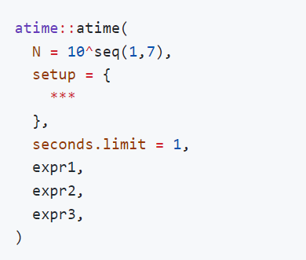
Example of code

Slide 6
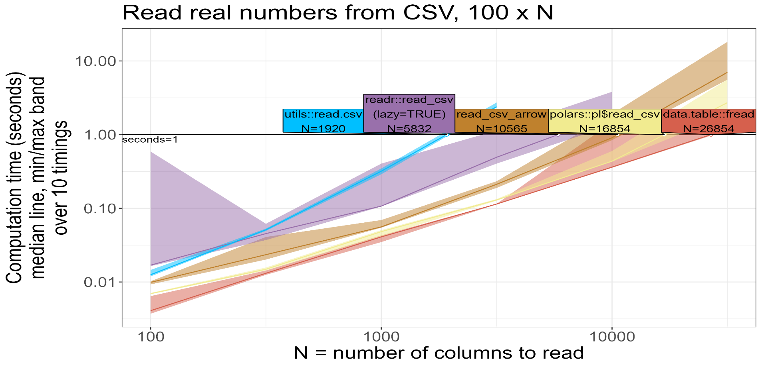
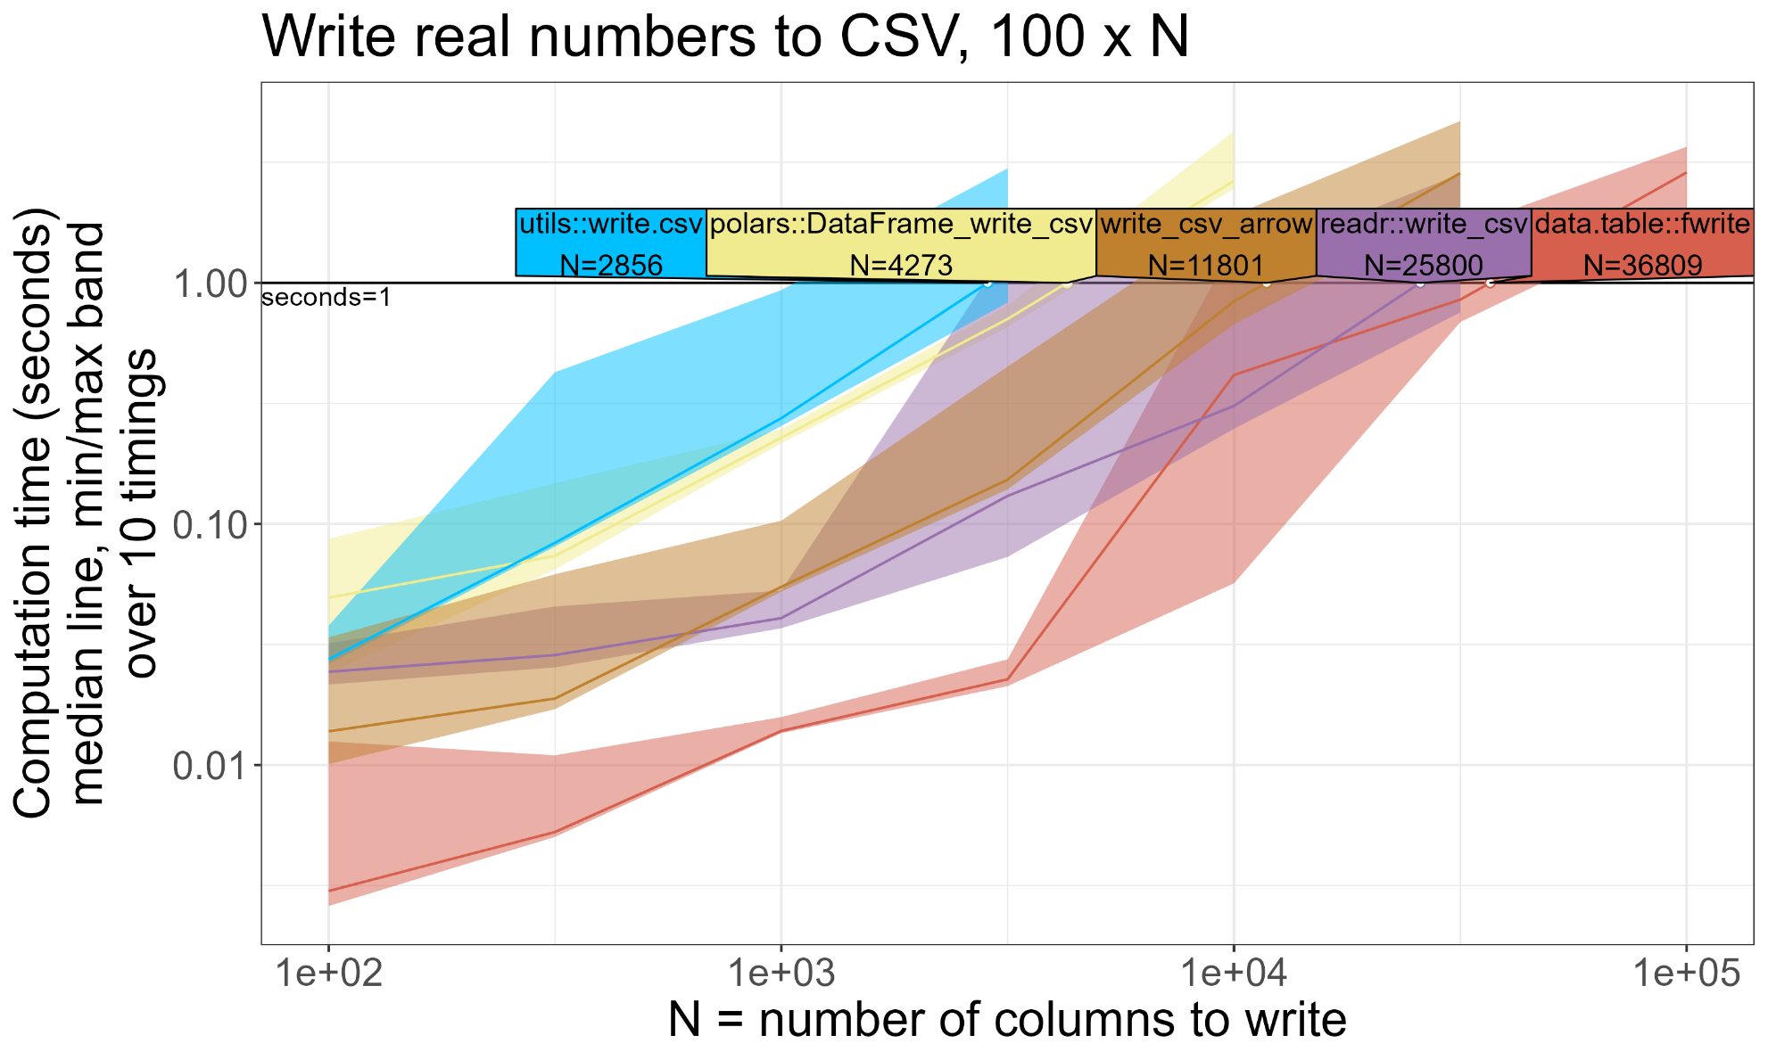
Reading and Writing CSV Files, data.table and other R packages

Slide 7
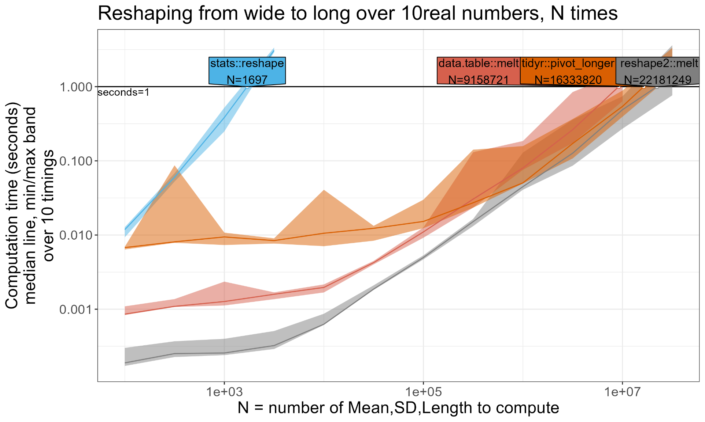
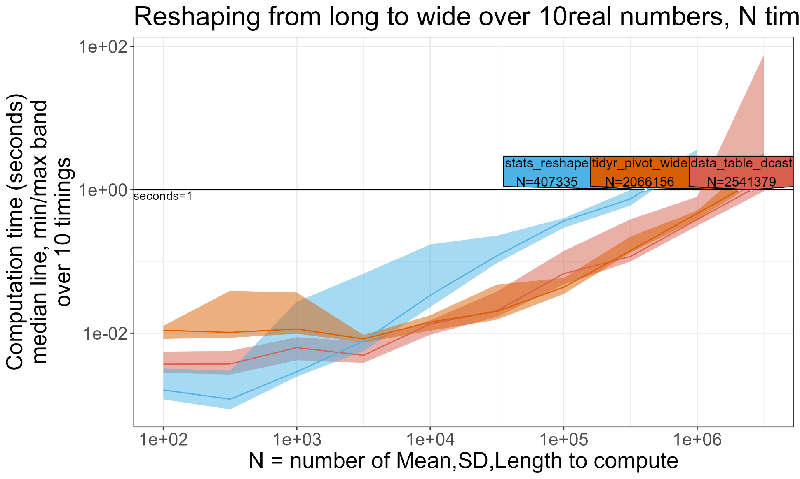
Reshaping Data, data.table and other R packages

Slide 8
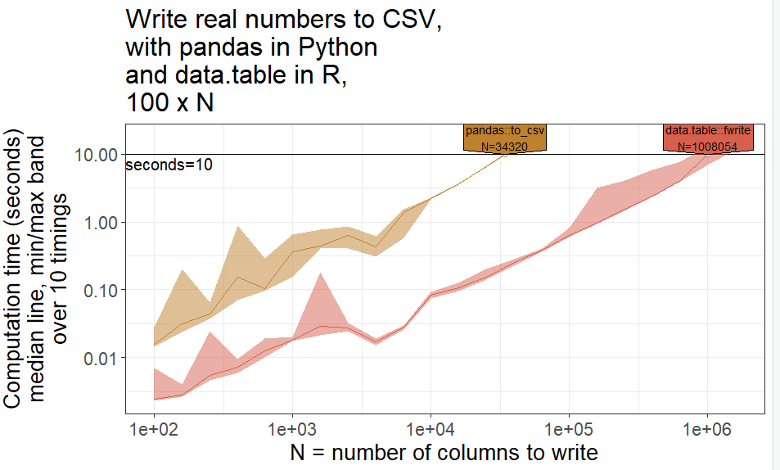
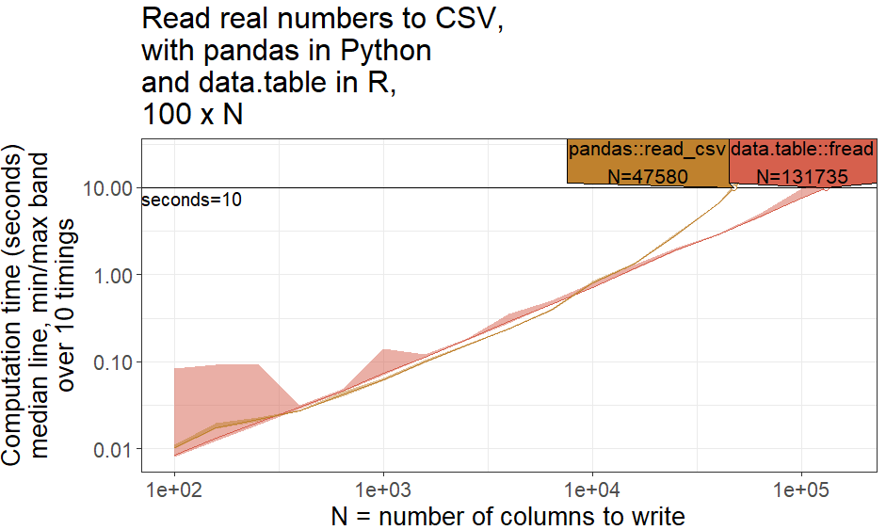
Writing and Reading CSV Files, data.table and pandas

Slide 9
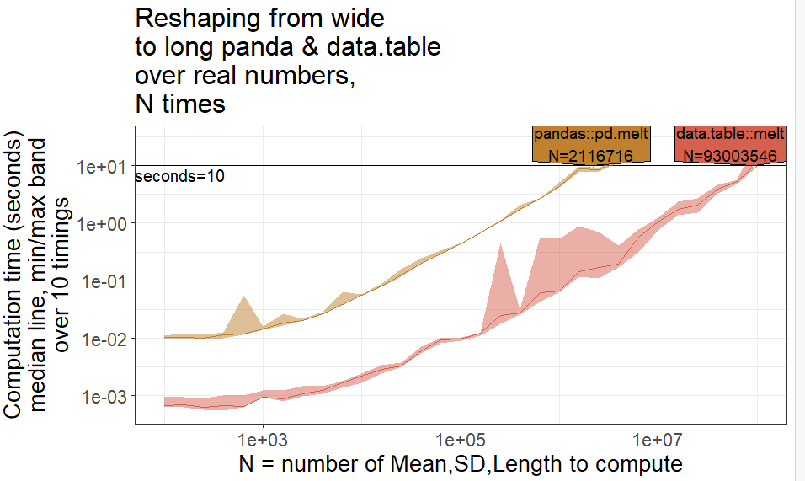
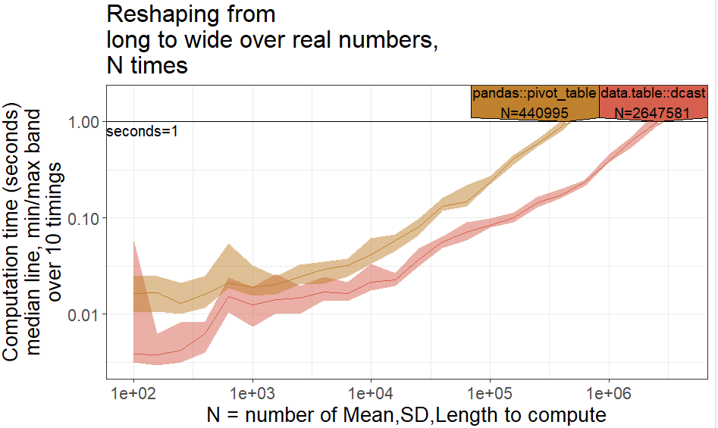
Reshaping Data, data.table and pandas

Slide 10
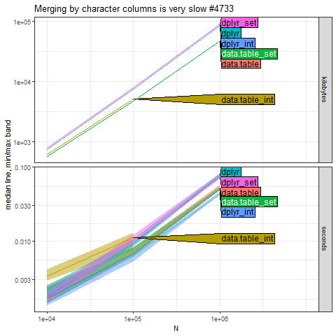
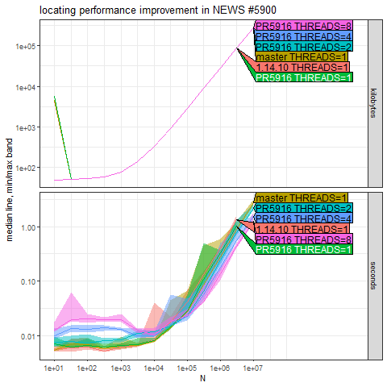

Slide 11
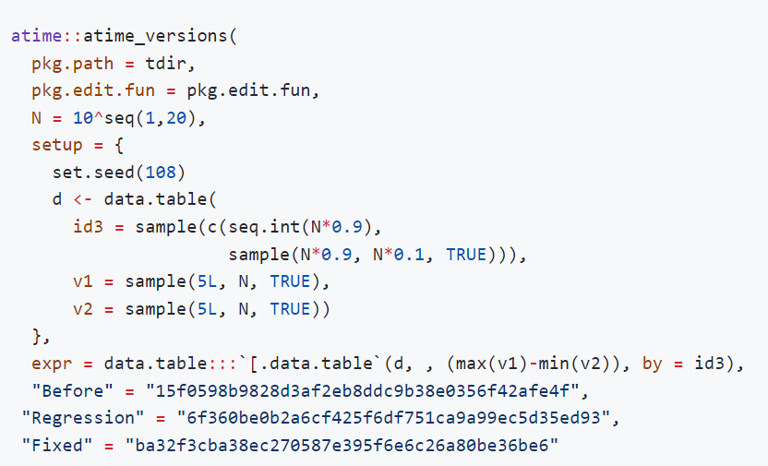
Example of code

Slide 12
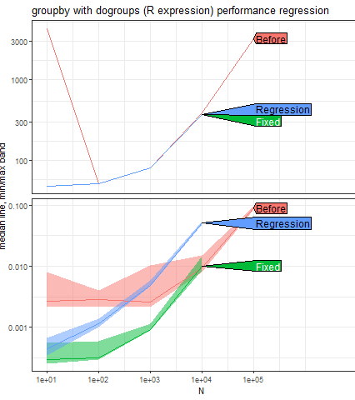
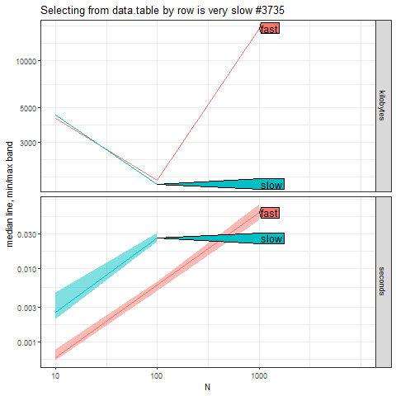

Slide 13
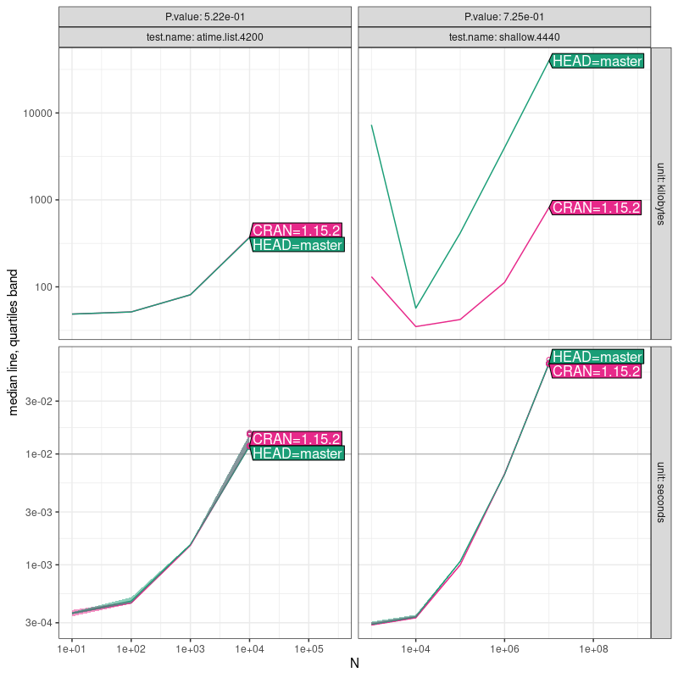
GitHub Action Results

Slide 14

Conclusion
xxxx

